Slide 1
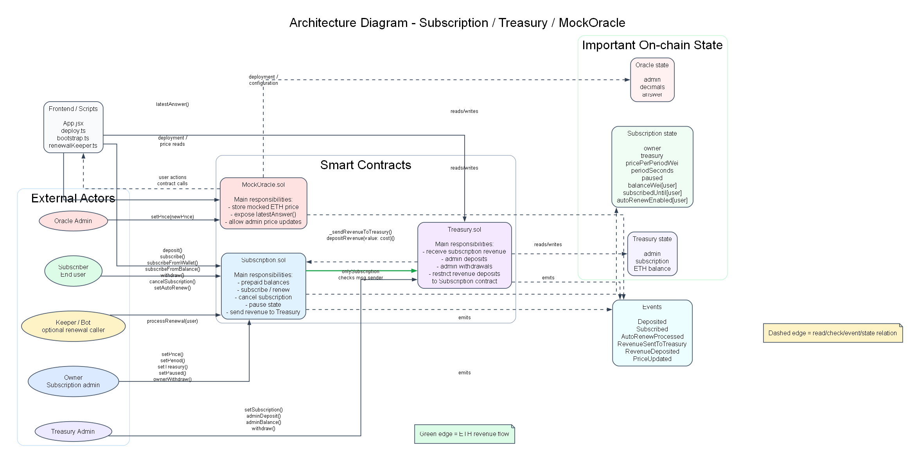
Testing a Blockchain Application Using Hardhat
T8 - Testarea unei retele Blockchain
Focusul proiectului: testare, nu aplicatia in sine
Stack: Hardhat, Mocha, Chai, ethers, TypeScript
Directii urmarite: unit, integration, security, performance

Slide 2
Project Goal
De ce proiectul este relevant pentru Testarea Sistemelor Software
Application under test
Subscription system cu 3 contracte: Subscription, Treasury, MockOracle
Obiectiv Principal
Sa validam comportamentul contractelor si interactiunea lor pe o retea Hardhat locala
Why testing matters here
Aplicatiile blockchain manipuleaza fonduri si stare permanenta; o eroare logica este costisitoare
Nu am urmarit doar functii izolate, ci fluxurile esentiale ale sistemului
Exemple: deposit, subscribe, renew, transfer catre Treasury, validari de roluri
Abordarea a fost ghidata de cerinta T8: unit + integration + security + performance

Slide 3
Why Hardhat and This Stack
Alegerea tool-urilor de testare
Hardhat: retea blockchain locala, scripting, debugging si testare automata
Mocha + Chai: descriere clara a scenariilor si asertiilor
ethers: interactiune directa cu contractele si conturile din retea
TypeScript: teste mai lizibile si mai usor de organizat
Comparativ cu Foundry / Truffle, Hardhat s-a potrivit cel mai bine cu stilul proiectului
Component | Version
Node.js | v22.17.0
Hardhat | ^2.22.3
Solidity | 0.8.26
Mocha | ^11.7.5
Chai | ^4.3.10
ethers | ^6.16.0

Slide 4
Test Suite Structure
Cum este organizata suita principala de teste
File | Main focus | Tests
test/Subscription.ts | subscription logic, state transitions, pause behavior | 8
test/TreasuryAndOracle.ts | permissions, treasury flow, oracle restrictions | 4
test/Performance.ts | gas consumption and comparative checks | 4
Functional testing
Validarea comportamentului: deposit, subscribe, renew, inputuri valide si invalide
Integration testing
Flux complet intre Subscription si Treasury, inclusiv trimiterea fondurilor
Security testing
Restrictii de roluri, invalid input, paused state, revenue restrictions
Performance testing
Masurarea costului de gas pentru operatiile importante ale sistemului
Total in suita principala: 16 teste, toate trecute cu succes
Key implementation techniques: loadFixture, time.increase, revertedWithCustomError, to.emit(...).withArgs(...)

Slide 5
Functional Testing Strategy
Equivalence classes + boundary value analysis
Am grupat comportamentele in clase de echivalenta pentru: deposit amount, payment source, renewal state si caller permissions
Am tratat explicit frontierele importante: 0 ETH, exact subscription price, insuficient funds, 0 periods, expirare vs. neexpirare
Testele verifica atat cazuri valide, cat si revert-uri cu custom errors
Exemple reprezentative: deposit(0), subscribe with insufficient funds, renewal before expiry, unauthorized admin call
Representative functional cases from README:
C1 deposit with 0 ETH -> AmountZero
C6 prepaid balance + wallet combined correctly
C10 renewal after expiry without funds -> not processed

Slide 6
Integration and Security Testing
Validam nu doar functii, ci si colaborarea si protectia sistemului
Integration: subscribe actualizeaza starea si trimite veniturile catre Treasury
Security: doar owner/admin/subscription au acces la operatiile sensibile
Se verifica zero-value operations, unauthorized calls si paused state
Scopul: contractele sa fie corecte si rezistente la utilizare gresita
Example security assertion:
unauthorized Treasury depositRevenue call -> revertedWithCustomError(NotSubscription)

Slide 7
Performance Testing Through Gas
In blockchain, costul executiei este o parte a calitatii
Operation | Gas used
deposit | 47360
subscribeFromWallet | 98429
subscribeFromBalance | 61429
processRenewal | 28875
withdraw | 38075
treasury.adminDeposit | 22858
treasury.withdraw | 33571
subscribeFromWallet este cel mai scump flux testat
renewal este mai ieftin decat o prima abonare din wallet
comparatia exact payment vs leftover credit sustine designul functional

Slide 8
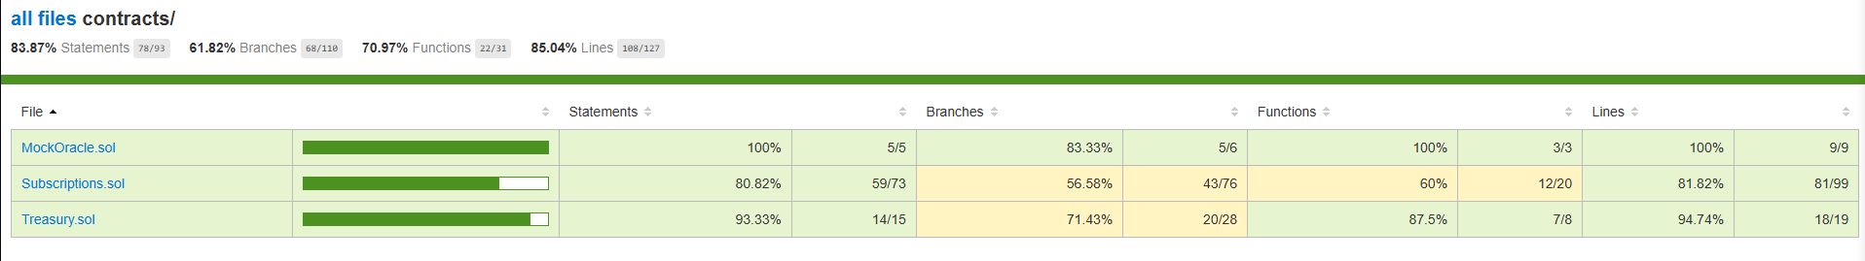
Coverage Results
Ce parte din logica contractelor este exercitata de teste
Statement coverage: 83.87% (78 / 93)
Branch coverage: 61.82% (68 / 110)
Function coverage: 70.97% (22 / 31)
Line coverage: 85.04% (108 / 127)
Contract | Statements | Branches | Functions | Lines
MockOracle.sol | 100% | 83.33% | 100% | 100%
Subscriptions.sol | 80.82% | 56.58% | 60% | 81.82%
Treasury.sol | 93.33% | 71.43% | 87.5% | 94.74%

Slide 9
AI-Assisted Testing
AI ca instrument complementar, nu ca inlocuitor
Criterion | Experiment 1 | Experiment 2 | Team suite
Workflow | ChatGPT ideas + Codex | Codex with repository context | Manual design
Tests passing | 6/6 | 12/12 | 16/16
Scope | basic missing checks | broader missing checks | core project coverage
Role | starting point | more reusable extension | baseline reference
Experiment 1 a fost util pentru idei si verificari simple, dar a ramas mai restrans
Experiment 2 a fost clar mai bun dupa ce AI-ul a primit contextul real din repository
Concluzia: contextul imbunatateste semnificativ calitatea testelor generate

Slide 10
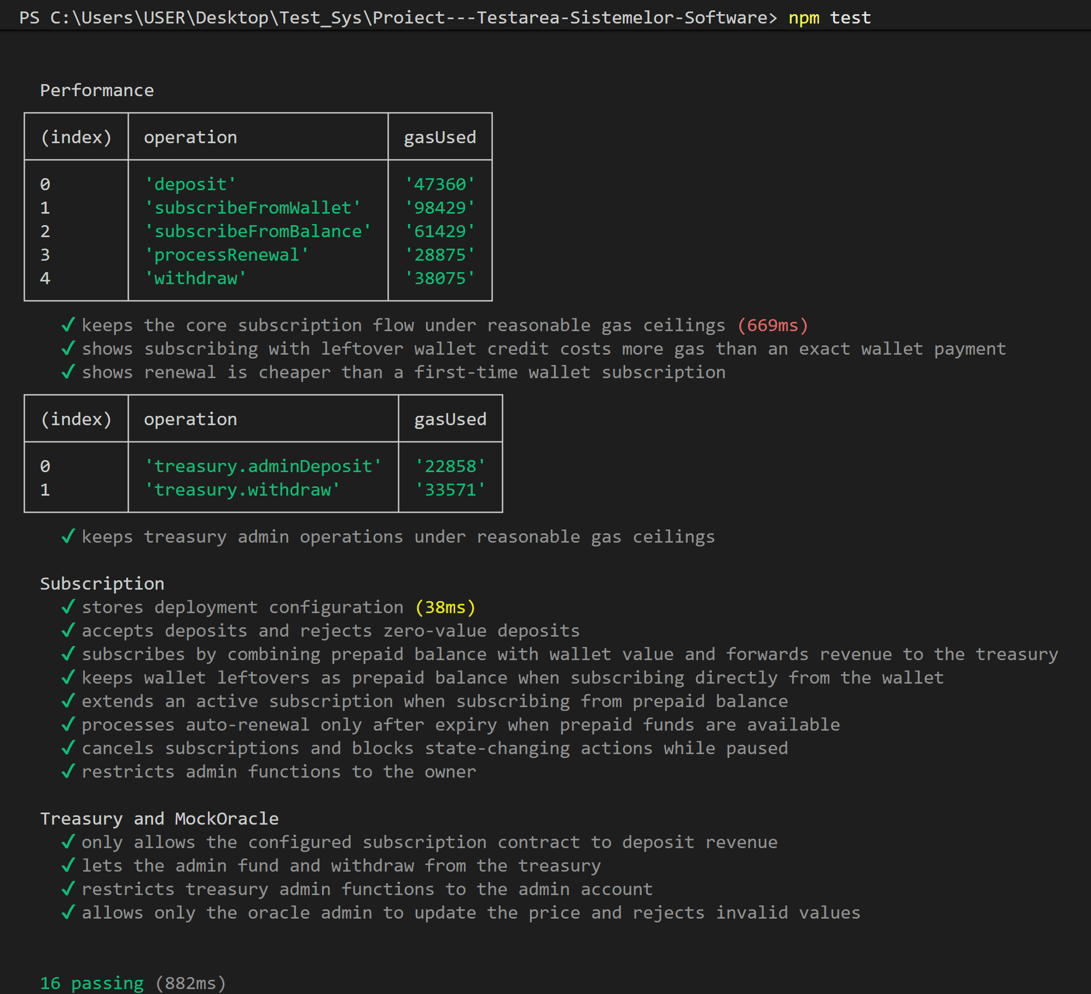
Concluzii
Ce demonstram prin acest proiect
Am construit o suita de teste axata pe cerinta T8: unit, integration, security, performance
Am validat atat logica locala a contractelor, cat si fluxurile dintre ele
Am masurat costul de gas si am analizat coverage-ul, nu doar rezultatul pass/fail
AI-ul a fost util ca extensie, dar suita scrisa de echipa ramane referinta principala
Multumim!

